Slide 1
Collection Framework
Introduction

Slide 2
Collection
An array is an indexed collection of fixed no of homogeneous data elements. (or)
An array represents a group of elements of same data type
The main advantage of array is we can represent huge no of elements by using single variable. So that readability of the code will be improved.

Slide 3
Limitations of Object[] array:
1) Arrays are fixed in size that is once we created an array there is no chance of increasing (or) decreasing the size based on our requirement hence to use arrays concept compulsory we should know the size in advance which may not possible always.
2) Arrays can hold only homogeneous data elements.

Slide 4
Example OF Object Array
Example:
Student[] s=new Student[10000];
s[0]=new Student();//valid
s[1]=new Customer();//invalid(compile time error)

Slide 5
Compile time error:
Test.java:7: cannot find symbol Symbol: class Customer Location: class Test s[1]=new Customer();
But we can resolve this problem by using object type array(Object[]).

Slide 6
Example OF Object Array
Example:
Object[] o=new Object[10000];
o[0]=new Student();
o[1]=new Customer();

Slide 7
Why Collection
Arrays concept is not implemented based on some data structure hence ready-made methods support we can’t expert. For every requirement we have to write the code explicitly.
To overcome the above limitations we should go for collections concept.

Slide 8
Why Collection
Collections are growable in nature that is based on our requirement we can increase (or) decrease the size hence memory point of view collections concept is recommended to use.
Collections can hold both homogeneous and heterogeneous objects.

Slide 9
Collection
Every collection class is implemented based on some standard data structure hence for every requirement ready-made method support is available being a programmer we can use these methods directly without writing the functionality on our own.

Slide 10
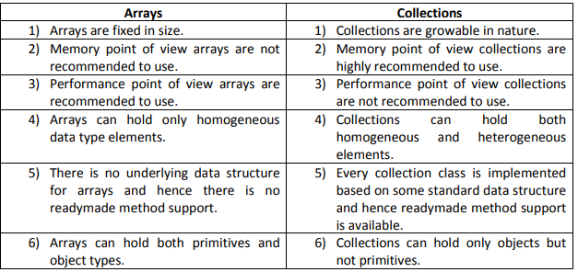
Differences between Arrays and Collections?

Slide 11
Collection
If we want to represent a group of objects as single entity then we should go for collections.

Slide 12
9(Nine) key interfaces of collection framework:
1. Collection
2. List
3. Set
4. SortedSet
5. NavigableSet
6. Queue
7. Map
8. SortedMap
9. NavigableMap

Slide 13
1.Collection:
If we want to represent a group of “individual objects” as a single entity then we should go for collection.
In general we can consider collection as root interface of entire collection framework.
Collection interface defines the most common methods which can be applicable for any collection object.

Slide 14
List:
It is the child interface of Collection.
If we want to represent a group of individual objects as a single entity where “duplicates are allow and insertion order must be preserved” then we should go for List interface.
Vector and Stack classes are reengineered in 1.2 versions to implement List interface.

Slide 15
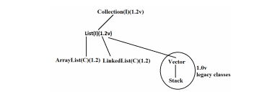
Collection

Slide 16
Set Interface
It is the child interface of Collection.
If we want to represent a group of individual objects as single entity “where duplicates are not allow and insertion order is not preserved” then we should go for Set interface.

Slide 17
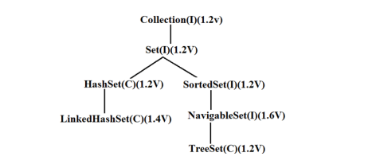
Set Interface

Slide 18
SortedSet:
It is the child interface of Set.
If we want to represent a group of “unique objects” according to some sorting order then we should go for SortedSet.

Slide 19
NavigableSet:
It is the child interface of SortedSet.
It provides several methods for navigation purposes.

Slide 20
Queue:
It is the child interface of Collection.
If we want to represent a group of individual objects prior to processing then we should go for queue concept.

Slide 21
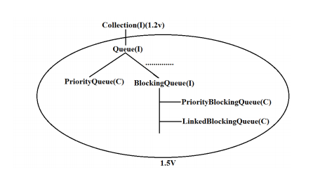
Queue

Slide 22
Conclusion
All the above interfaces (Collection, List, Set, SortedSet, NavigableSet, and Queue) meant for representing a group of individual objects.

Slide 23
Map
If we want to represent a group of objects as key-value pairs then we should go for Map.
Map is not child interface of Collection.
If we want to represent a group of objects as key-value pairs then we should go for Map interface.
Duplicate keys are not allowed but values can be duplicated.

Slide 24
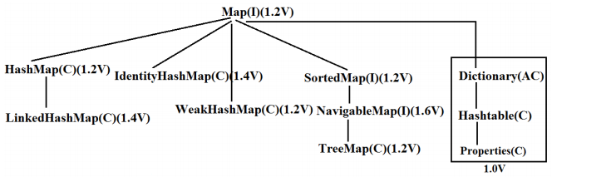
Map Interface

Slide 25
SortedMap:
It is the child interface of Map.
If we want to represent a group of objects as key value pairs “according to some sorting order of keys” then we should go for SortedMap.

Slide 26
NavigableMap:
It is the child interface of SortedMap and defines several methods for navigation purposes.

Slide 27
What is the difference between Collection and Collections?
“Collection is an “interface” which can be used to represent a group of objects as a single entity. Whereas “Collections is an utility class” present in java.util package to define several utility methods for Collection objects. Collection--------------------interface
Collections------------------class

Slide 28
Legacy Character
In collection framework the following are legacy characters.
1) Enumeration(I)
2) Dictionary(AC)
3) Vector(C)
4) Stack(C)
5) Hashtable(C)
6) Properties(C)

Slide 29
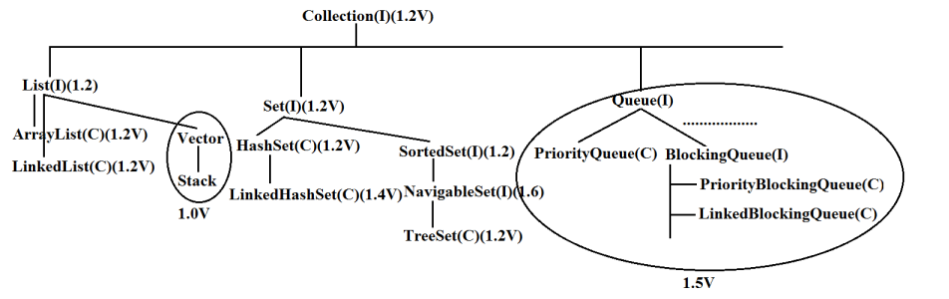
Collection

Slide 30
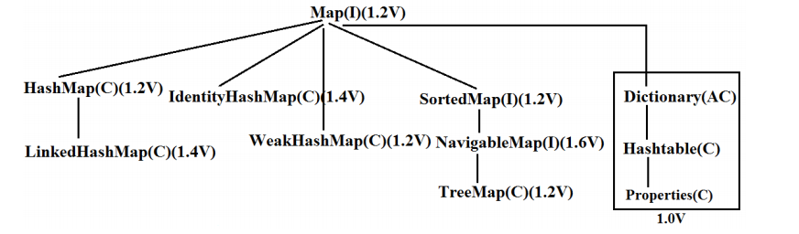
Map

Slide 31
Collection interface:
If we want to represent a group of individual objects then we should go for Collection interface. This interface defines the most common general methods which can be applicable for any Collection object.

Slide 32
methods of Collection interface
1) boolean add(Object o);
2) boolean addAll(Collection c);
3) boolean remove(Object o);
4) boolean removeAll(Object o);
5) boolean retainAll(Collection c);

